Slide 1
Analyzing Ferrari’s last years in F1 - Talend portion -
Luca Sannino 1542194

Slide 2
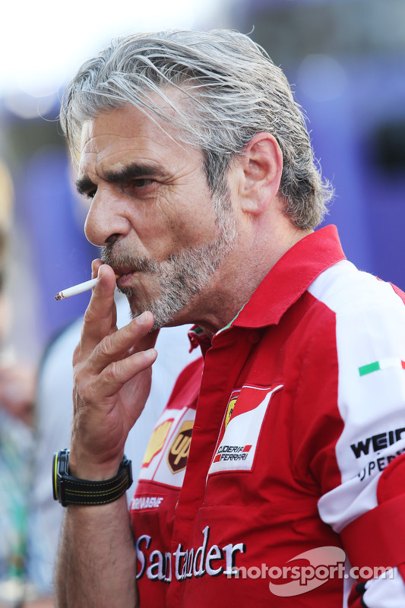


• Hi, my name is Luca…
and I’ve recently become the new team principal at Ferrari!
2014-2019
2019-2020
2020-????

Slide 3
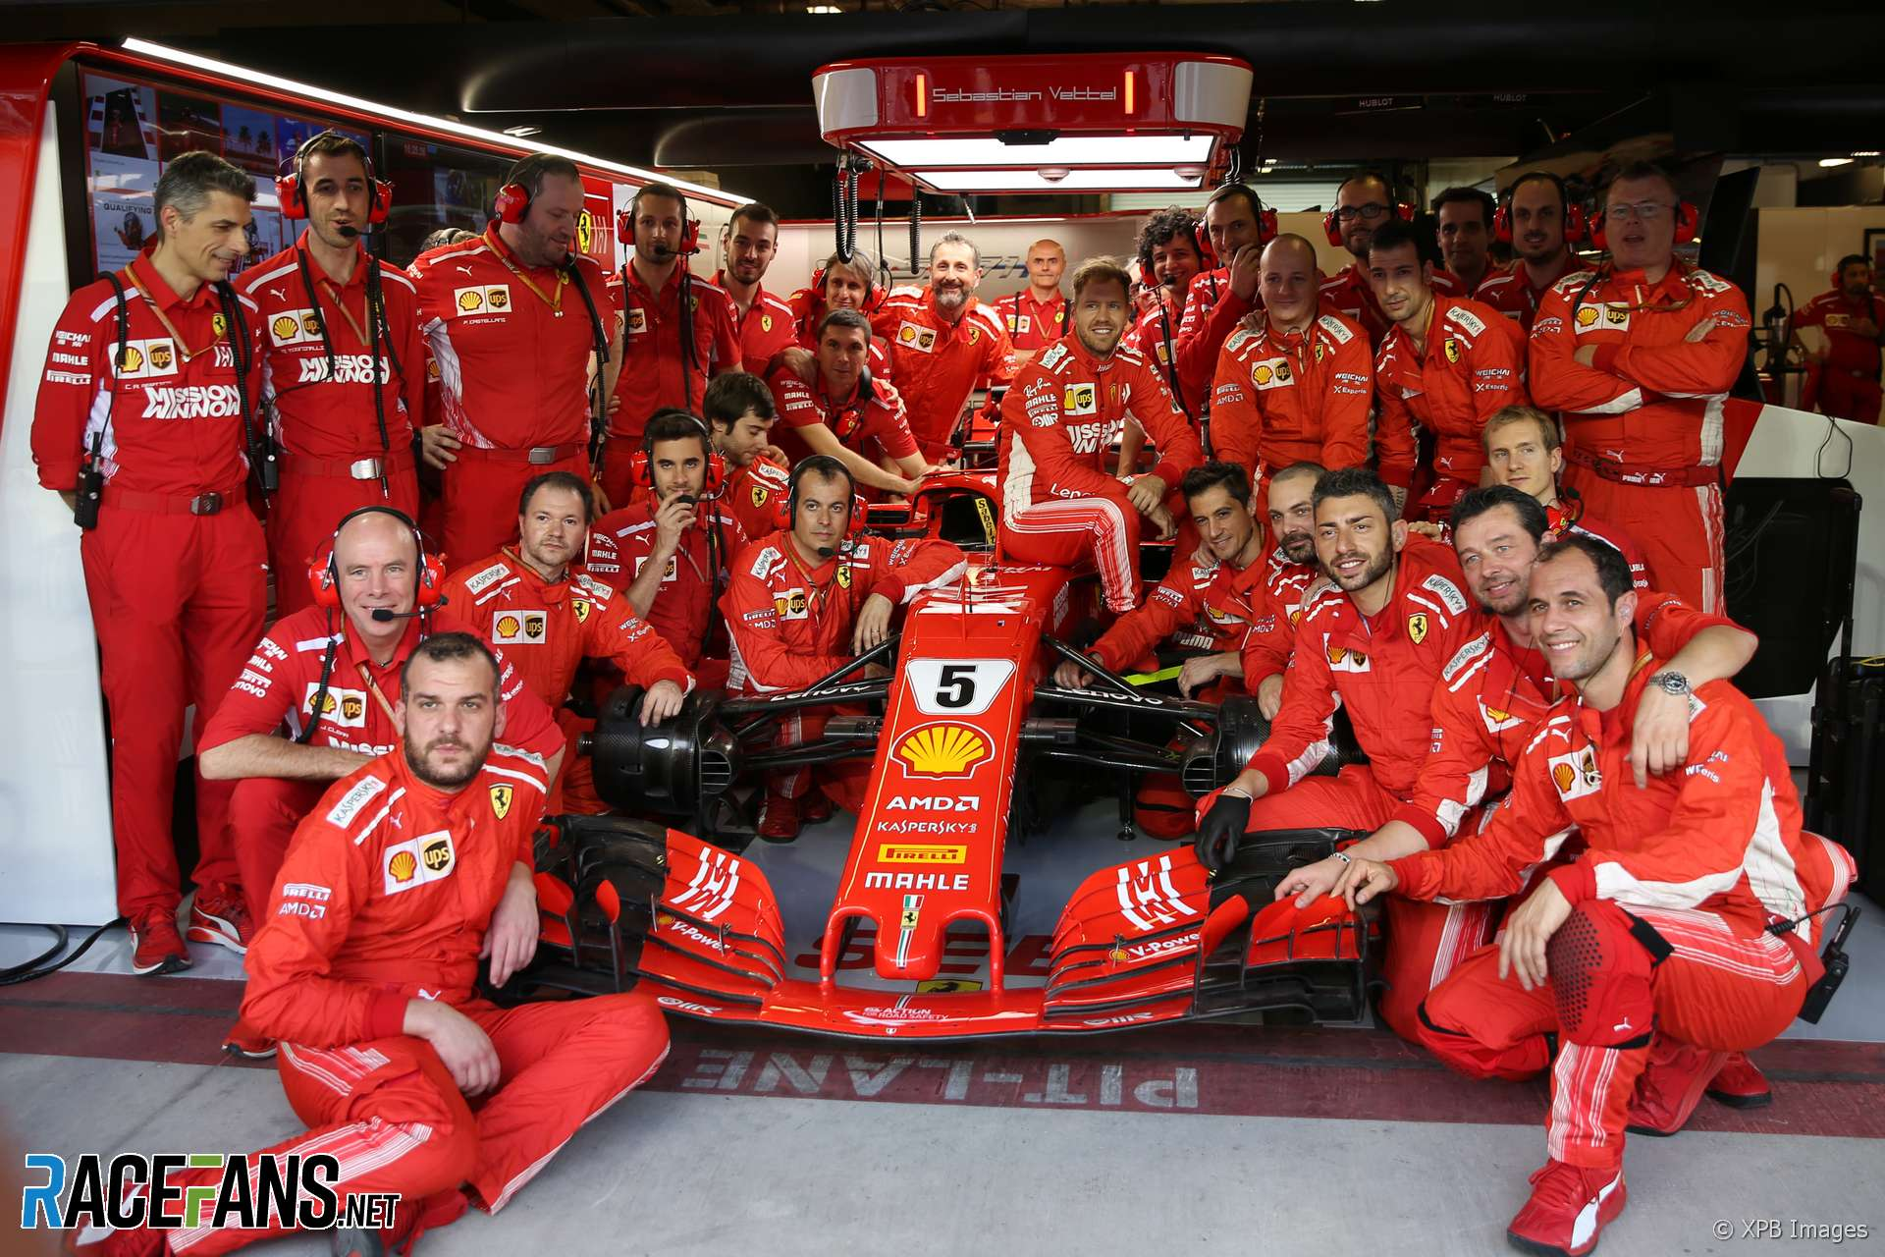
• As a team principal, it is my duty to keep improving the team so that we can compete with the other constructors and, hopefully, win the season.
• However, before I can improve something, I first need to understand WHAT it needs to be improved!

Slide 4
• So I’ve selected three areas where I feel the team is not meeting my expectations.
POTENTIAL ISSUES
1 – Our pit stops are subpar
2 – Vettel is underperforming
3 – The car is slower than Mercedes’
• The objective of this project is to change that “where I feel” to “where I know”. How?
• By using a graph database to query data obtained after an integration process.
• This portion will focus on the integration!

Slide 5
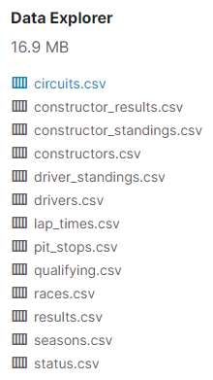

• My instruments for this portion will be:
Talend Data Integration: an open-source software that allows the user to perform ETL operations
A series of .csv files containing stats from the entire F1 history

Slide 6
POTENTIAL ISSUE 1
Are our pit stops subpar?

Slide 7
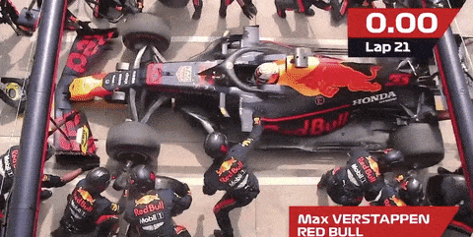
• Last year Red Bull registered the quickest pit stop in the entire history of Formula 1.
WHAT I WANT TO KNOW
Was it just luck or a symptom of a bigger problem: that we are just slower?

Slide 8
• The objective of this exercise will be to collect all of our pit stops from last year by integrating the .csv files, and then using the output to calculate the average pit stop time per pilot. After doing the same for Red Bull, we will compare the results and see how we stack up.
• Note: the portion on the graph database will use more generic global mappings, but here I wanted more complex queries in order to showcase Talend’s functionalites. The same holds true for all the following exercises.
• Let’s begin by finding our pit stops by integrating the sources!

Slide 9
SOURCE SCHEMAS
- pitStops(raceId, driverId, stop, lap, time, duration, milliseconds)
drivers(driverId, driverRef, number, code, forename, surname, dob, nationality, url)
races(raceId, year, round, circuitId, name, date, time, url)
GLOBAL SCHEMA
- Ferrari2019PitStops(pilot, race, date, stop, lap, duration)
GAV MAPPING
{ (a, b, c, d, e, f) | pitStops(x1, x2, d, e, y1, f, y2), races(x1, 2019, y3, y4, a, b, y5, y6), drivers(x2, y7, y8, y9, a, x3, y10, y11, y12), (x3 == “Vettel” || x3 == “Leclerc”) } -> Ferrari2019PitStops(a, b, c, d, e, f)
Note: in the sources there’s no info about constructors!

Slide 10
• Finding Red Bull pit stops won’t be as trivial since there was a mid-season driver swap last year.
RED BULL Max Verstappen Pierre Gasly
TORO ROSSO Alexander Albon Daniil Kvyat
swap
• We are not interested in pit stops from Toro Rosso, so we have to make sure that Gasly and Albon were driving for Red Bull before extracting their pit stop times from a specific race!

Slide 11
ADDITIONAL SOURCE SCHEMAS
results(resultId, raceId, driverId, constructorId, number, …)
constructors(constructorId, constructorRef, name, nationality, url)
GLOBAL SCHEMA
- RedBull2019PitStops(pilot, race, date, stop, lap, duration)
GAV MAPPING
{ (a, b, c, d, e, f) | pitStops(x1, x2, d, e, y1, f, y2), races(x1, 2019, y3, y4, a, b, y5, y6), drivers(x2, y7, y8, y9, a, y10, y11, y12, y13),
results(y14, x1, x2, x3, y15, …), constructors(x3, y16, “Red Bull”, y17, y18) } -> RedBull2019PitStops(a, b, c, d, e, f)

Slide 12
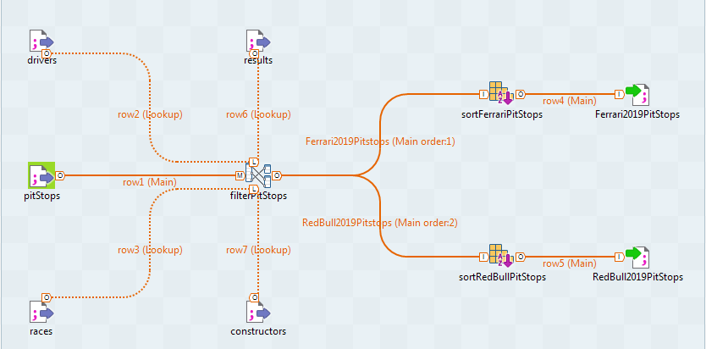
• Now let’s see how this works in practice with a live demonstration using Talend!

Slide 13

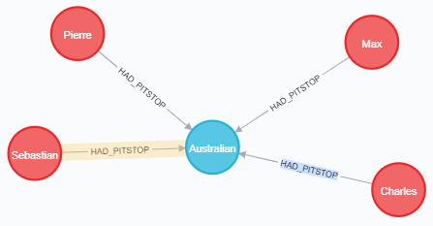
• Once we have integrated our data, we must query it in order to obtain the averages. We can do this by inserting our data as a input .csv file to a graph database (like Neo4j) and query the data there!
But this is another topic for another time! Let’s see if we can replicate the same results just by using Talend data transformation tools!

Slide 14
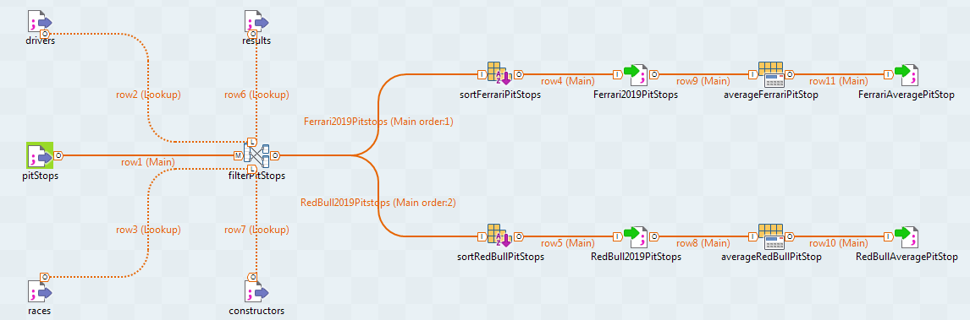
• Now let’s see how this works in practice with a live demonstration using Talend!

Slide 15
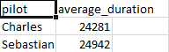
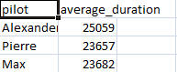
CONCLUSIONS
• Looking at the results, and since Albon raced in too few races to make his average relevant, it’s fair to say that our pit stops are slower. We need either to improve or account for a ~1 second delay when making strategies that involve pitting.

Slide 16
POTENTIAL ISSUE 2
Is Vettel underperforming?

Slide 17
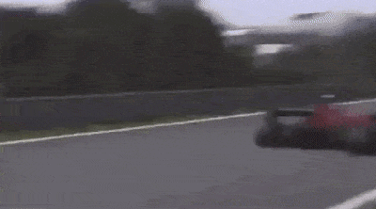
• Last year many claimed Vettel was feeling the pressure from his new teammate, Leclerc, which led him to some major mistakes.
WHAT I WANT TO KNOW
Is Vettel in a difficult situation, or are people just blinded by the hype for our younger driver?

Slide 18
• The objective of this exercise will be to collect all the placements of Vettel since he joined F1, alongside the ones of his various teammates, by integrating the .csv files. We’ll then use the output to calculate how many times he has placed better than his teammate per season, so that we can see if there was a downgrade in his perfomance across the years.
• Let’s begin by collecting the relevant placements!

Slide 19
SOURCE SCHEMAS
- results(resultId, raceId, driverId, constructorId, number, …, position, …)
- drivers(driverId, driverRef, number, code, forename, surname, dob, nationality, url)
races(raceId, year, round, circuitId, name, date, time, url)
constructors(constructorId, constructorRef, name, nationality, url)
GLOBAL SCHEMA
- VettelAgainstTeammates(race, date, year, vettel_position, teammate, teammate_position, constructor )

Slide 20
GLOBAL SCHEMA
- VettelAgainstTeammates(race, date, year, vettel_position, teammate, teammate_position, constructor )
GAV MAPPING
{ (a, b, c, d, e, f, g) | results(y1, x1, x2, x3, y2, …, d, …), races(x1, c, y3, y4, a, b, y5, y6), drivers(x2, y7, y8, y9, y10, “Vettel”, y11, y12, y13), constructors(x3, y14, g, y15, y16),
results(y17, x1, x4, x3, y18, …, f, …),
drivers(x4, y19, y20, y21, y22, e, y23, y24, y25),
x2 != x4,
c >= 2008 } -> VettelAgainstTeammates(a, b, c, d, e, f, g)
The drivers must be different
First full season for Vettel

Slide 21
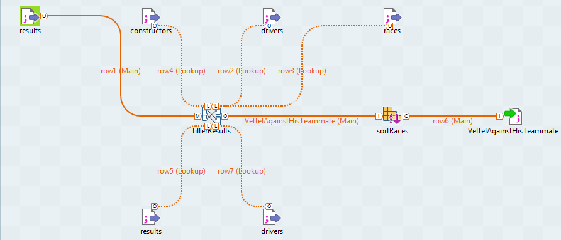
• Now let’s see how this works in practice with a live demonstration using Talend!

Slide 22
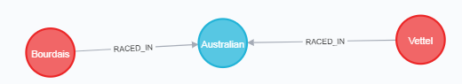
• After integrating our data, we must query it in order to count how many times Vettel has placed better than his teammate per season. Again, we can use a graph database like Neo4j
• We can still use Talend’s transformation tools however!

Slide 23
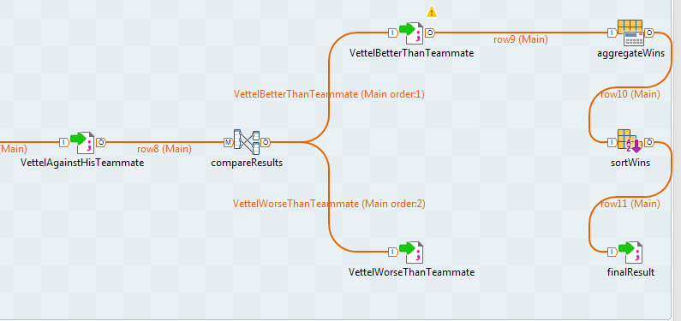
• Now let’s see how this works in practice with a live demonstration using Talend!

Slide 24
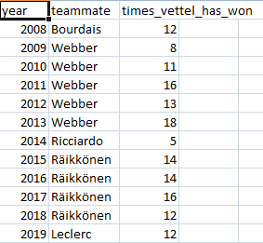
CONCLUSIONS
• Even though Vettel had a hard time against Leclerc, it was surprising to learn that it wasn’t any better last year or in 2014, where Ricciardo clearly gave a stronger performance!

Slide 25
POTENTIAL ISSUE 3
Are we slower than Mercedes?

Slide 26
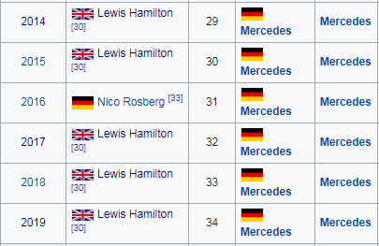
• It’s not a secret that Mercedes is dominating the recent era of Formula 1.
WHAT I WANT TO KNOW
Is this the result of unlucky circumstances or is our car just slower?

Slide 27
• The objective of this exercise will be to collect all fastest laps during races from both Mercedes and Ferrari since 2014 by integrating the .csv files. We’ll then use the output to filter the races where each driver had the opportunity to register a valid fast lap, and then sum the fast lap times grouped by season and pilot, and ultimately compare the results and see who has a quicker time.
• Let’s begin by collecting the fastest laps!

Slide 28
SOURCE SCHEMAS
- results(resultId, raceId, driverId, constructorId, number, …, fastestLap, …, fastestLapTime, …)
drivers(driverId, driverRef, number, code, forename, surname, dob, nationality, url)
races(raceId, year, round, circuitId, name, date, time, url)
constructors(constructorId, constructorRef, name, nationality, url)
GLOBAL SCHEMAS
FerrariFastestLapTimes(race, date, year, driver, lap, time)
MercedesFastestLapTimes(race, date, year, driver, lap, time)

Slide 29
GLOBAL SCHEMA
FerrariFastestLapTimes(race, date, year, driver, lap, time)
GAV MAPPING
{ (a, b, c, d, e, f) | results(y1, x1, x2, x3, y2, …, e, …, f, …), races(x1, c, y3, y4, a, b, y5, y6), drivers(x2, y7, y8, y9, y10, d, y11, y12, y13), constructors(x3, y14, “Ferrari”, y15, y16),
f != “\N”,
c >= 2014 } -> FerrariFastestLapTimes(a, b, c, d, e, f)
“\N” doesn’t mean that the value of a fastest lap is unknown, but that the driver didn’t have the chance to register one!

Slide 30
GLOBAL SCHEMA
MercedesFastestLapTimes(race, date, year, driver, lap, time)
GAV MAPPING
{ (a, b, c, d, e, f) | results(y1, x1, x2, x3, y2, …, e, …, f, …), races(x1, c, y3, y4, a, b, y5, y6), drivers(x2, y7, y8, y9, y10, d, y11, y12, y13), constructors(x3, y14, “Mercedes”, y15, y16),
f != “\N”,
c >= 2014 } -> MercedesFastestLapTimes(a, b, c, d, e, f)

Slide 31
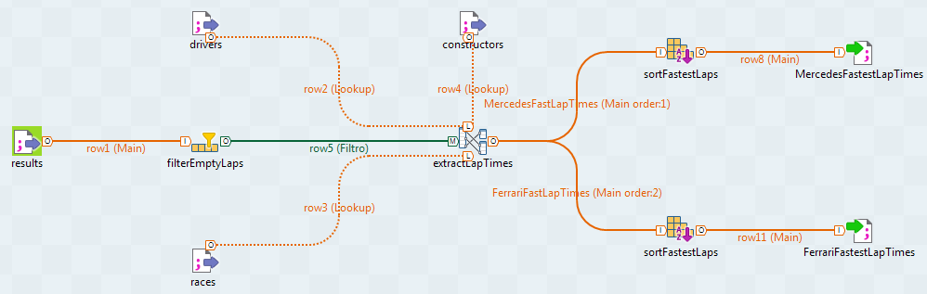
• Now let’s see how this works in practice with a live demonstration using Talend!

Slide 32
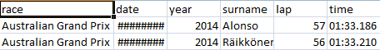
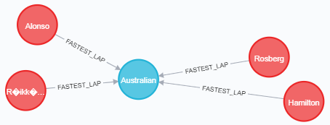
• Once again we can query the integrated data after it has been loaded in a graph database.
• But let’s keep using Talend!

Slide 33
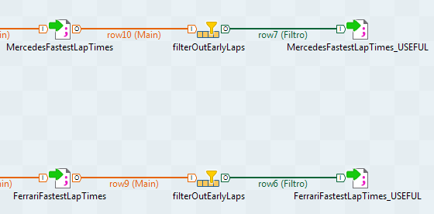
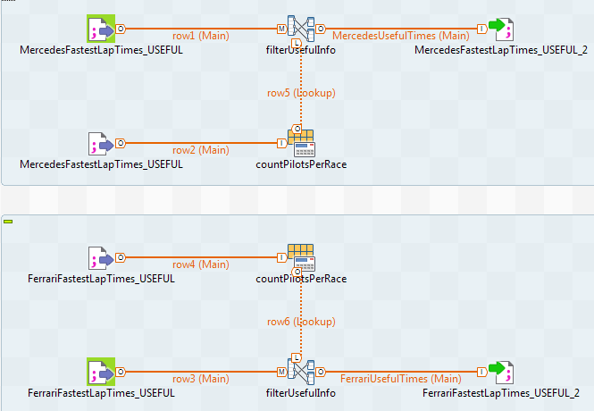
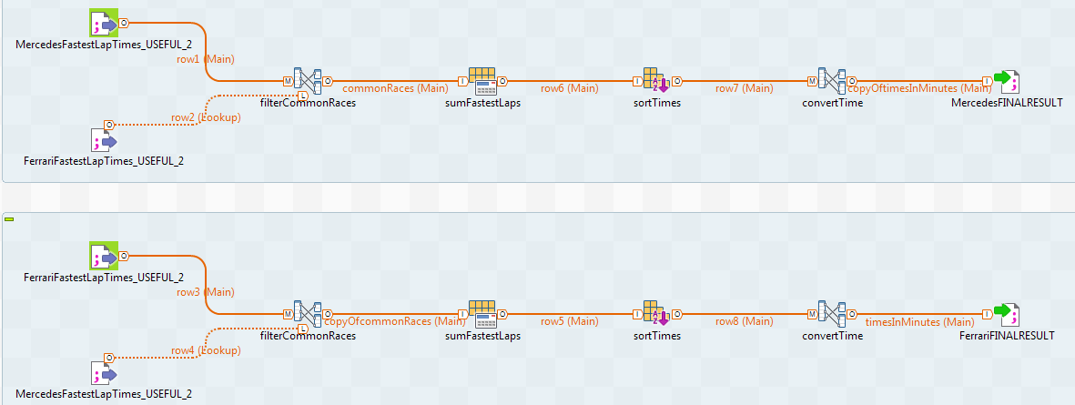
All this work just to emulate one Neo4j query!
• Now let’s see how this works in practice with a live demonstration using Talend!

Slide 34
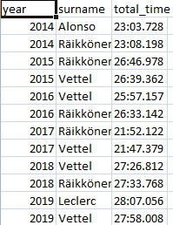
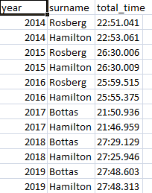
CONCLUSIONS
• This data shows that we clearly need to keep improving the performance of our car because Mercedes is still ahead!

Slide 35
FINAL REMARKS
• By integrating and querying data, I could take a authentic look at how various aspects of the team have performed and where - and if - they fell short. • The answers I gained from this analysis will help me make decisions in the future that will be based on facts and not subjective feelings, which was exactly my initial objective!

Slide 36
BONUS
Let’s make more mappings!

Slide 37
SOURCE SCHEMAS
- results(resultId, raceId, driverId, constructorId, number, …, position, …, statusId)
drivers(driverId, driverRef, number, code, forename, surname, dob, nationality, url)
races(raceId, year, round, circuitId, name, date, time, url)
constructors(constructorId, constructorRef, name, nationality, url)
circuits(circuitId, circuitRef, name, location, country, lat, alt, url)
status(statusId, status)
GLOBAL SCHEMAS
FerrariWins(race, date, year, surname, name)
FerrariDNF(race, date, year, surname, name, status)
italianCircuits(name, location)
italianDrivers(surname, name, dob)
italianConstructors(name)

Slide 38
GLOBAL SCHEMAS
FerrariWins(race, date, year, surname, name)
FerrariDNF(race, date, year, surname, name, status)
GAV MAPPINGS
{ (a, b, c, d, e) | results(y1, x1, x2, x3, y2, …, 1, …), races(x1, c, y3, y4, a, b, y5, y6), drivers(x2, y7, y8, y9, d, e, y10, y11, y12), constructors(x3, y13, “Ferrari”, y14, y15) } -> FerrariWins(a, b, c, d, e)
{ (a, b, c, d, e, f) | results(y1, x1, x2, x3, y2, …, “\N”, …, x4), races(x1, c, y3, y4, a, b, y5, y6), drivers(x2, y7, y8, y9, d, e, y10, y11, y12), constructors(x3, y13, “Ferrari”, y14, y15)
status(x4, f) } -> FerrariDNF (a, b, c, d, e, f)

Slide 39
GLOBAL SCHEMAS
italianCircuits(name, location)
italianDrivers(surname, name, dob)
italianConstructors(name)
GAV MAPPINGS
{ (a, b) | circuits(y1, y2, a, b, “Italy”, y3, y4, y5) }
-> italianCircuits(a, b)
{ (a, b, c) | drivers(y1, y2, y3, y4, b, a, c, “Italian”, y5) }
-> italianDrivers(a, b, c)
{ (a) | constructors(y1, y2, a, “Italian”, y3) } -> ItalianConstructors(a)

Slide 40
SOURCE SCHEMAS
- pitStops(raceId, driverId, stop, lap, time, duration, milliseconds) - results(resultId, raceId, driverId, constructorId, number, grid, position, …, fastestLap, …, fastestLapTime, …, statusId)
drivers(driverId, driverRef, number, code, forename, surname, dob, nationality, url)
races(raceId, year, round, circuitId, name, date, time, url)
constructors(constructorId, constructorRef, name, nationality, url)
circuits(circuitId, circuitRef, name, location, country, lat, alt, url)
status(statusId, status)
GLOBAL SCHEMAS
Pitstops(race, circuit, date, year, surname, name, stop, lap, duration, constructor) - Results(race, circuit, date, year, surname, name, constructor, grid, position, status) - FastestLaps(race, circuit, date, year, surname, name, constructor, fastestLap, fastestLapTime)

Slide 41
GLOBAL SCHEMA
Pitstops(race, circuit, date, year, surname, name, stop, lap, duration, constructor)
GAV MAPPING
{ (a, b, c, d, e, f, g, h, i, l) | pitStops(x1, x2, g, h, y1, i, y2), races(x1, d, y3, x4, a, c, y4, y5), drivers(x2, y6, y7, y8, f, e, y9, y10, y11),
results(y12, x1, x2, x3, y13, …) constructors(x3, y14, l, y15, y16)
circuits(x4, y17, b, y18, y19, y20, y21, y22) } -> Pitstops(a, b, c, d, e, f, g, h, i, l)

Slide 42
GLOBAL SCHEMA
Results(race, circuit, date, year, surname, name, constructor, grid, position, status)
GAV MAPPING
{ (a, b, c, d, e, f, g, h, i, l) | results(y1, x1, x2, x3, y2, h, i, …, x5) races(x1, d, y3, x4, a, c, y4, y5), drivers(x2, y6, y7, y8, f, e, y9, y10, y11), constructors(x3, y14, g, y15, y16)
circuits(x4, y17, b, y18, y19, y20, y21, y22)
status(x5, l) } -> Results(a, b, c, d, e, f, g, h, i, l)

Slide 43
GLOBAL SCHEMA
FastestLaps(race, circuit, date, year, surname, name, constructor, fastestLap, fastestLapTime)
GAV MAPPING
{ (a, b, c, d, e, f, g, h, i) | results(y1, x1, x2, x3, y2, …, h …, i, …) races(x1, d, y3, x4, a, c, y4, y5), drivers(x2, y6, y7, y8, f, e, y9, y10, y11), constructors(x3, y14, g, y15, y16)
circuits(x4, y17, b, y18, y19, y20, y21, y22)
h != “\N” } -> FastestLaps(a, b, c, d, e, f, g, h, i)

Slide 44
REFERENCES
• Kaggle F1 Dataset: https://www.kaggle.com/rohanrao/formula-1-world-championship-1950-2020
• Talend Website: https://www.talend.com/
• Neo4j Website: https://neo4j.com/

